Slide 1
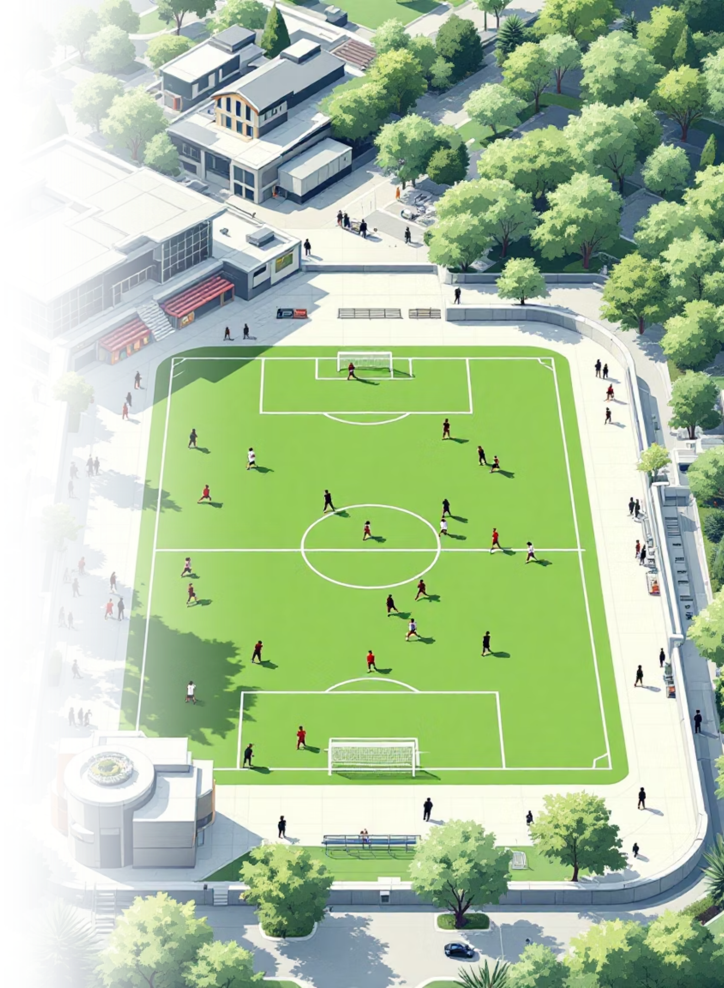
Radiant Rovers Football Academy
Player Performance Analysis
Prepared by: Muddassir Mushtaq Mulla
48 PLAYERS
20 MATCHES
DATA-DRIVEN INSIGHTS

Slide 2





End-to-End Analytics Pipeline
CSV Data
Raw match performance records
Python Analysis
Pandas & NumPy processing
PostgreSQL
KPI calculations
Power BI
Interactive dashboard

Slide 3
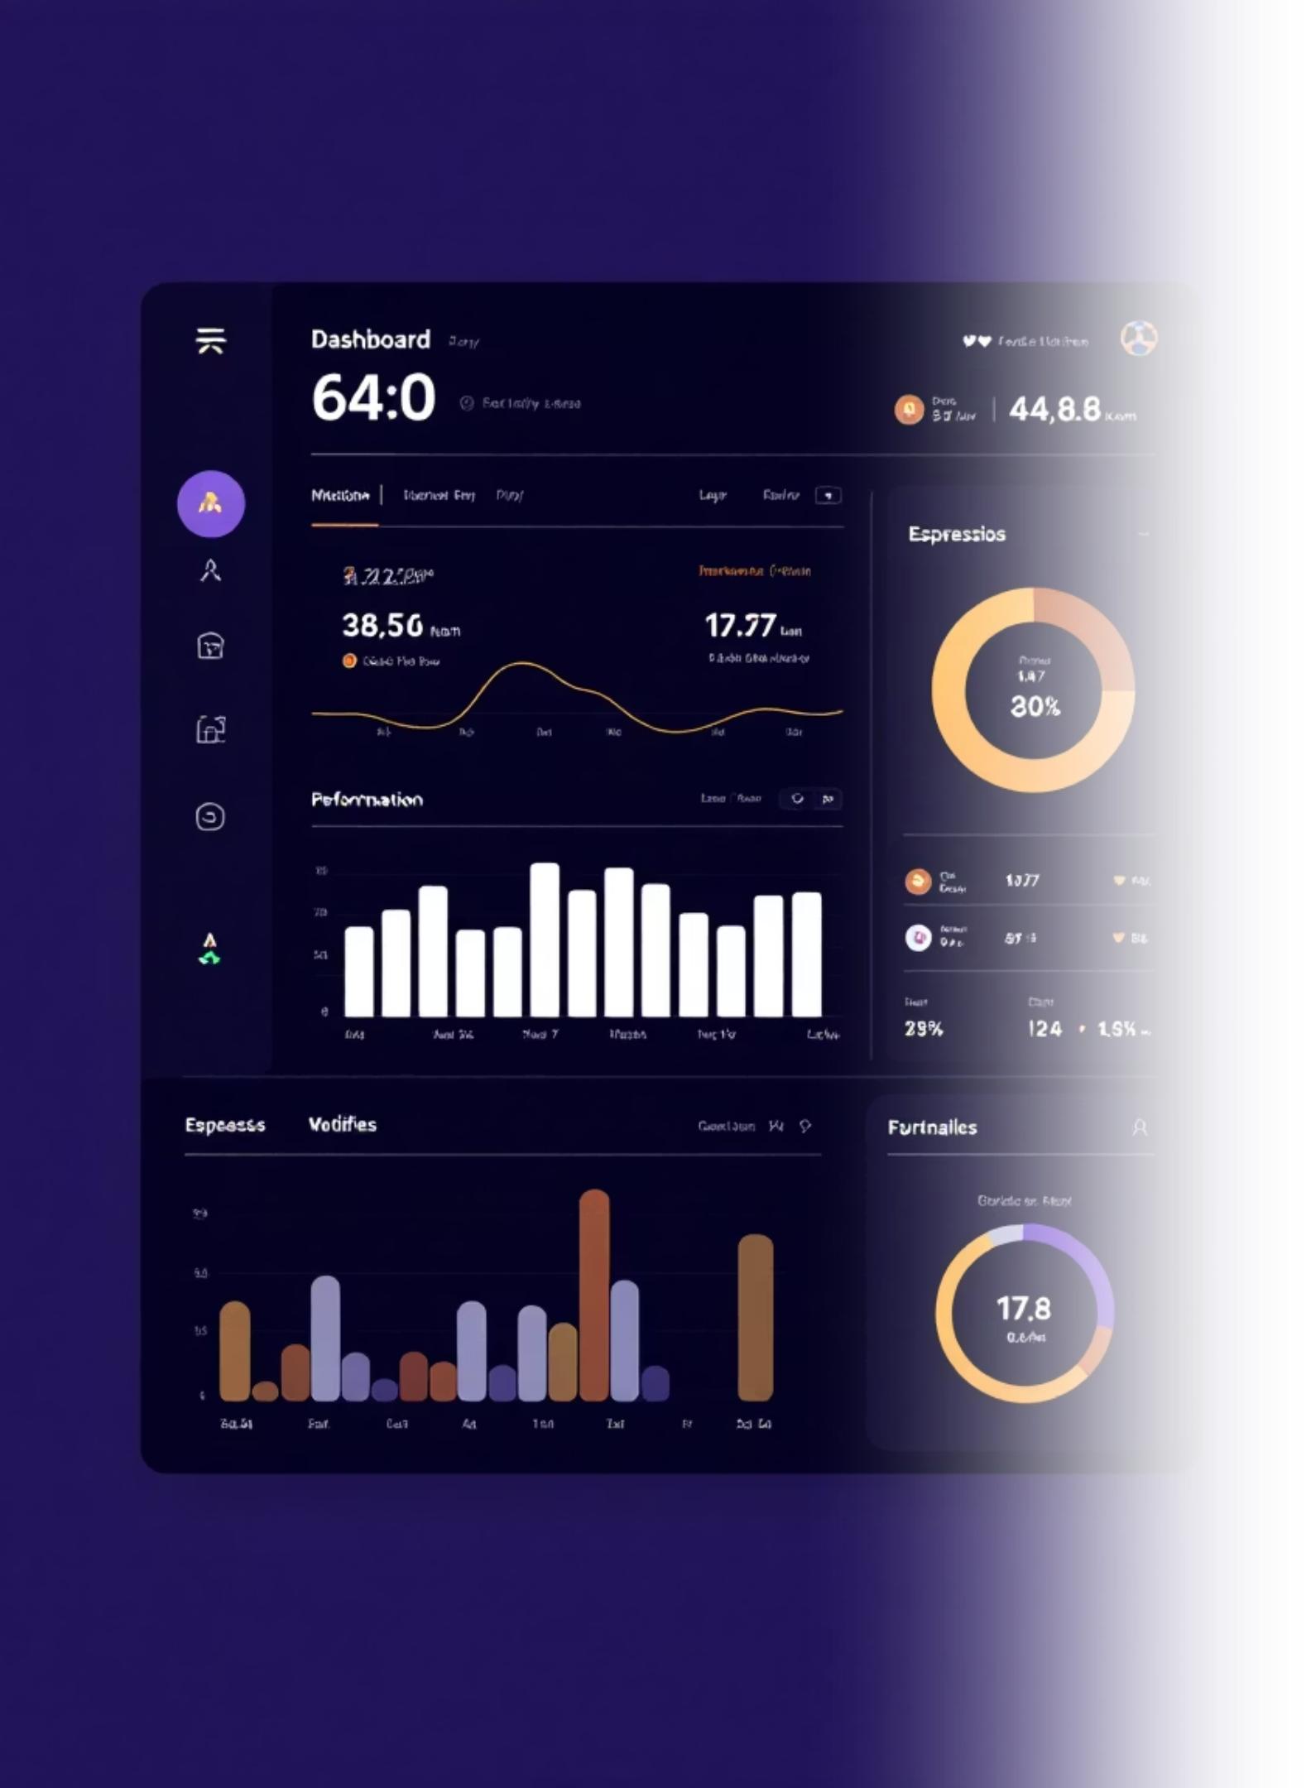
Dataset Overview
960
48
20
Total Records
Players
Matches
Player-match performance data
Academy roster analyzed
Competitive games tracked
Player Information
Match Details
Player ID & Name
Match ID & Date
Age
Minutes Played
Playing Position
Attendance

Slide 4
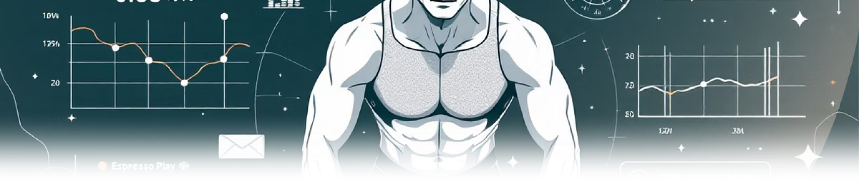

Performance & Fitness Metrics
Performance
Fitness
Training
Goals, Assists, Shots on Target, Tackles, Passing Accuracy
Fitness Score, Stamina, Speed
Attendance tracking and consistency indicators

Slide 5
Python Data Processing
01
02
03
Data Loading
Cleaning
Standardization
CSV import using Pandas, initial inspection with df.info() and df.describe()
Converted numeric columns, replaced missing values with 0 for goals/assists
Consistent column names, formatted positions, parsed match dates
04
05
Feature Engineering
Database Export
Created Goals per 90 minutes, aggregated player metrics
Loaded to PostgreSQL using SQLAlchemy for KPI analysis

Slide 6
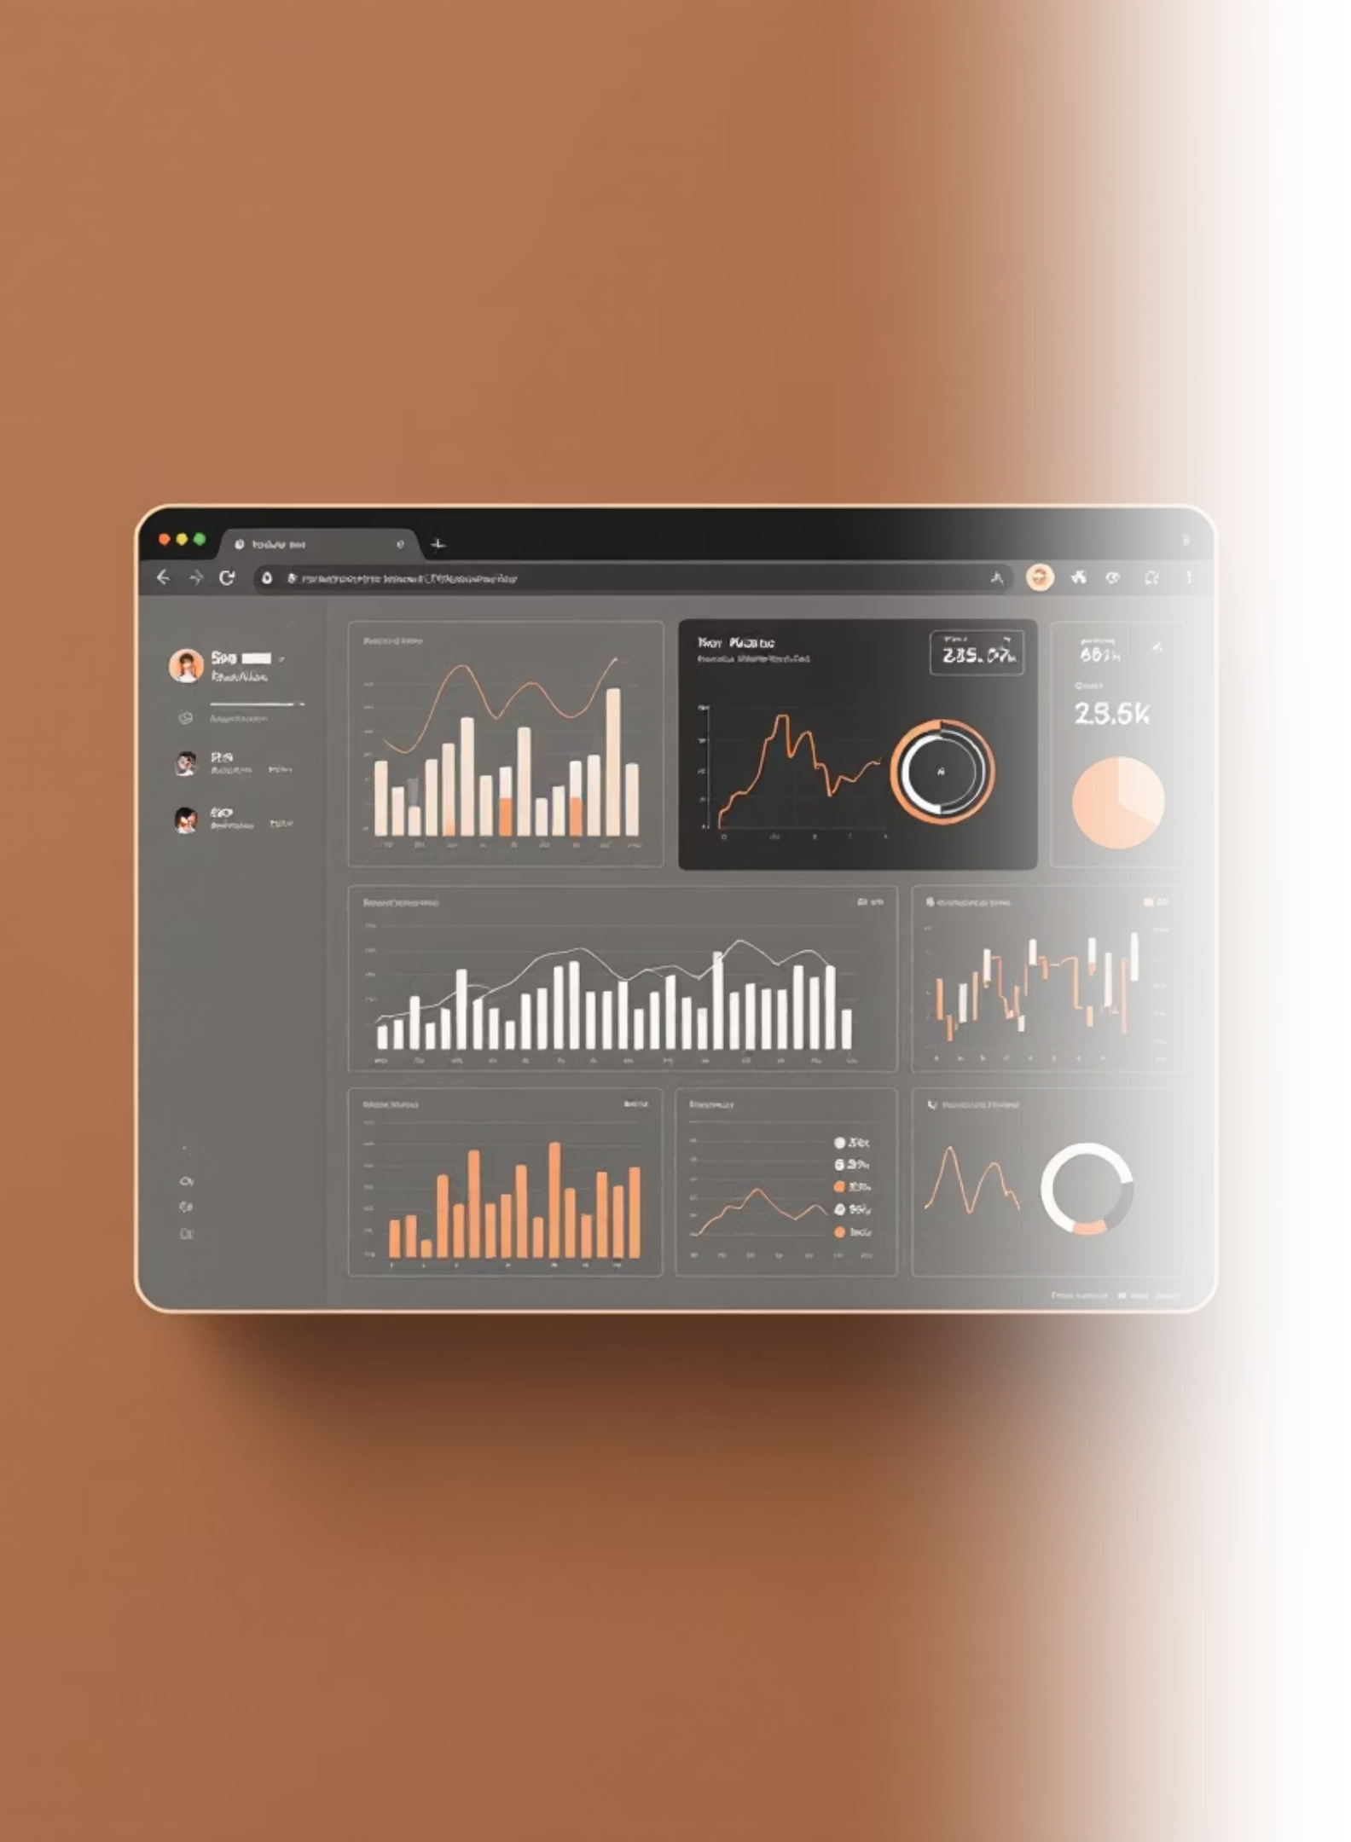
Key Performance Indicators
1.6
Average goals per match (player-sum)
Rudransh
Zaid Shaikh
4 Goals (Top Scorer)
4 Goals (Tied Top Scorer)
Abdul Raafe
3 Goals
Passing Accuracy by Position
Fitness Trends by Age
Attendance Consistency
Age 12: 70.55
MID: 70.31%
5 players with 100% attendance rate
Age 13: 69.80
GK: 67.98%
Age 14: 69.40
FWD: 64.67%
Age 15: 69.85
DEF: 64.53%

Slide 7

Top Performers of the Academy
Rudransh (P1021)
1
4 Goals
0.28 Goals per 90 minutes
Zaid Shaikh (P1030)
2
4 Goals
0.27 Goals per 90 minutes
Abdul Raafe (P1038)
3
3 Goals
0.21 Goals per 90 minutes
Mohmd. Amir (P1042)
4
3 Goals
0.24 Goals per 90 minutes
Saif Solkar (P1044)
5
3 Goals
0.21 Goals per 90 minutes
These rankings are based on goals-per-90 efficiency metric, which provides a fair comparison across varying playing times.

Slide 8
SQL Analysis Results
Top Goal Scorers
Passing by Position
Fitness by Age
Rudransh and Zaid Shaikh lead with 4 goals each, followed by Abdul Raafe with 3 goals
Midfielders excel at 70.31% accuracy; Defenders need targeted drills at 64.53%
Age 12 players show highest fitness (70.55); Age 17 players at 68.84 require conditioning focus

Slide 9

Power BI Dashboard
Performance Overview
Player Leaderboard
Total goals: 32 | Assists tracked | Goals per match: 1.6
Rudransh (0.28 goals/90) | Zaid Shaikh (0.27 goals/90) | Mohmd. Amir (0.24 goals/90)
Fitness & Development
Match Analysis
Age-based fitness trends | U12: 70.55 | U18: 70.62
Shots on target tracked | Attendance monitoring | 20 total matches analyzed
Interactive slicers enable drill-down by position (DEF, MID, FWD, GK), age group (U12-U18), and individual player selection for detailed performance insights.

Slide 10
Coaching Recommendations
Improve Finishing
Optimize Playing Time
Position-Specific Training
Targeted drills for players with high shots but lower goals
Increase minutes for high goals-per-90 efficiency players
Tailored passing drills, especially for defenders
Fitness Conditioning
Attendance Monitoring
Focused sessions for lower fitness-score age groups
Track engagement and consistency indicators

Slide 11





Impact & Conclusion
Coaching Decision
Best performing players recommended for starting XI based on goals-per-90 and fitness trends, resulting in improved attacking output in subsequent matches.
Data Preparation
KPI Analysis
Python-based cleaning and transformation
SQL-driven performance metrics
Actionable Results
Visualization
Coaching decisions and player development
Power BI interactive insights
Practical sports analytics application delivering real coaching value through data-driven insights for player development and performance tracking.

